Slide 1
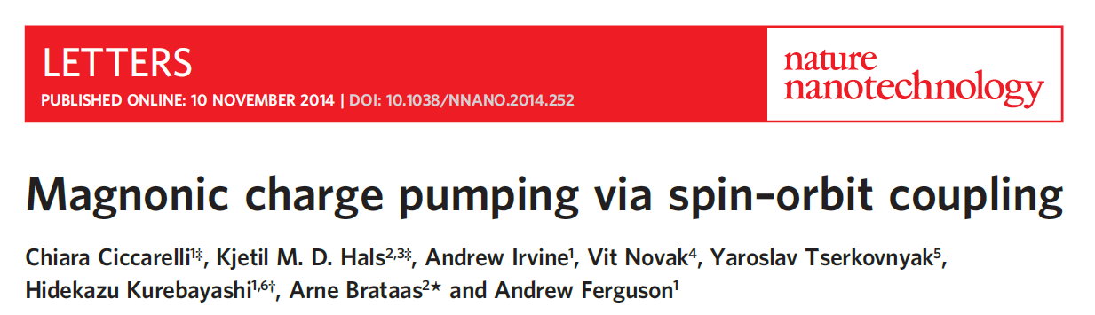

Slide 2
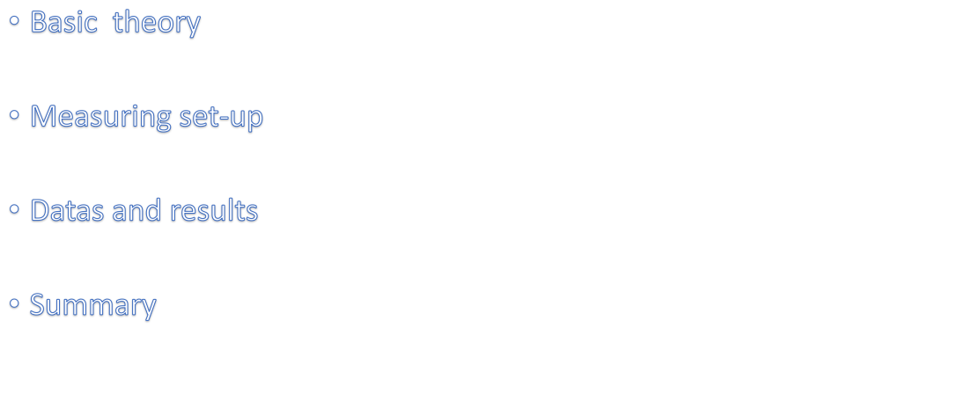
Outline

Slide 3
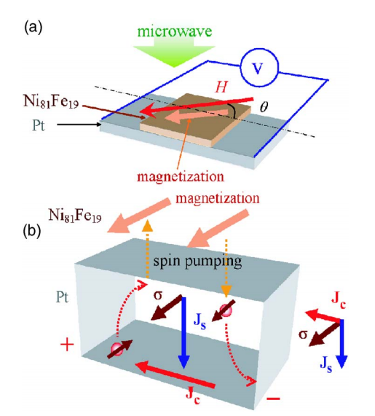
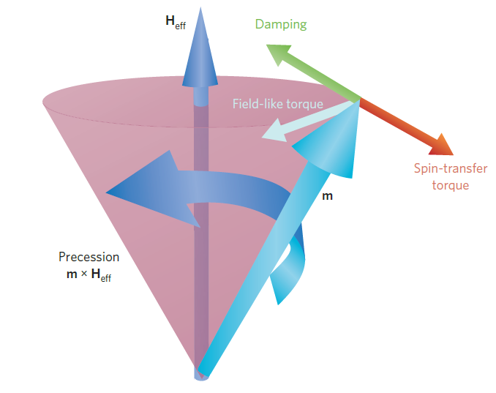


reciprocal effects

Slide 4



magnonic charge pumping: direct conversion of magnons into charge currents via spin–orbit coupling
In ferromagnets, excitations of magnons result in a net non-equilibrium spin accumulation due to the exchange interaction, yielding an average velocity response that produces an alternating current density.

Slide 5
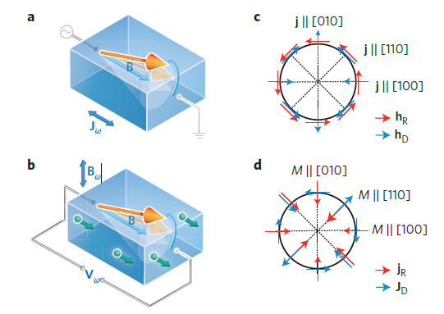


charge pumping
SOT
charge pumping and SOT induces FMR in (Ga,Mn)As

Slide 6

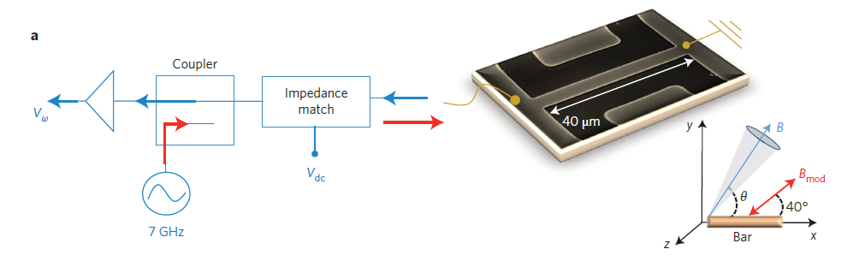
field modulation lock-in technique get to filtered out background due to the reflected signal.
charge pumping
A microwave is launched to generate microwave current via an impedance-matching circuit
During magnetization precession, frequency mixing between the induced microwave current and the oscillating
AMR leads to a time-independent voltage V_{dc}

Slide 7
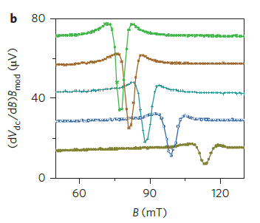

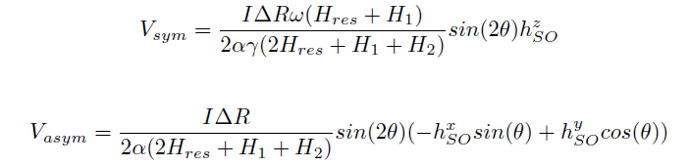
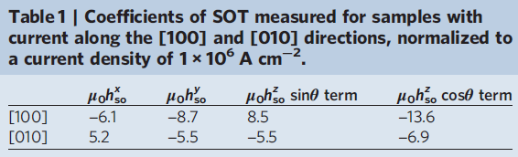
decomposing the resonance curves into symmetric and anti-symmetric Lorentzians
Derivative of the rectified voltage along the a [100]-oriented bar as the magnetic field is swept along different in-plane directions

Slide 8
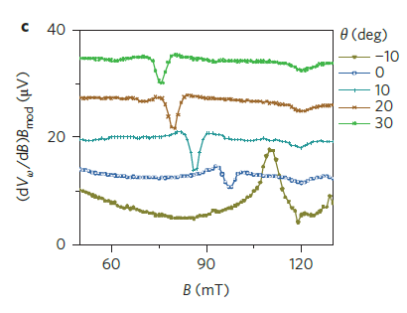
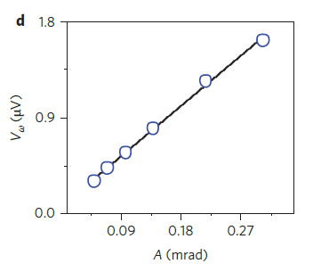
Derivative of the charge pumping voltage along the a [100]-oriented bar as the magnetic field is swept along different in-plane directions
Amplitude of microwave voltage V_{ω} as a function of precessional amplitude A
The value of A (in mrad) is obtained from the amplitude of the rectified voltage |V_{dc}| = |I|R_{AMR}A/2, where I is the microwave current passing through the bar and R_{AMR} is the anisotropic magneto-resistance coefficient

Slide 9
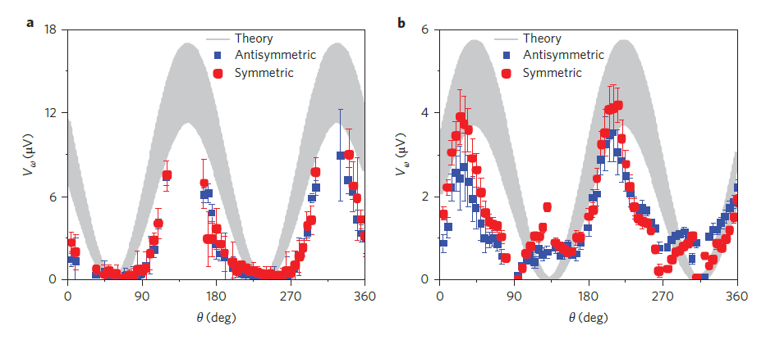
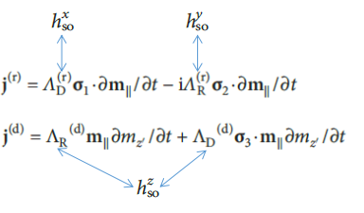

Theory:
Experimental:
decomposing the resonance curves of into symmetric and anti-symmetric Lorentzians
[100]
[010]
Theoretical modelling and experimental datas of measured angular dependence of charge pumping

Slide 10

